Slide 1

Analysis on Unemployment in India
Unemployment remains a persistent challenge in India, with complex socioeconomic factors shaping its dynamics. This data visualization analysis aims to uncover key trends, insights, and potential interventions to address this critical issue.

Slide 2
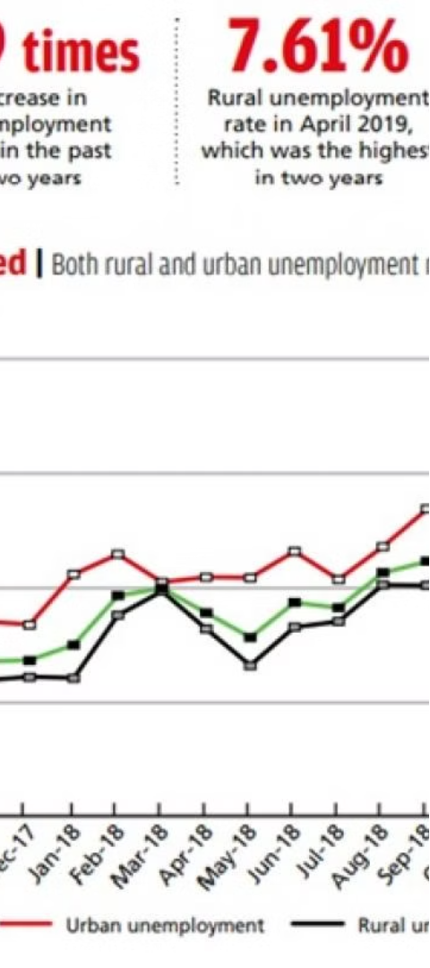
Overview of Unemployment Trends in India
1
Rising Unemployment Rates
Unemployment rates in India have shown an upward trend in recent years, with significant variations across demographics and regions.
2
Demographic Shifts
India's young and growing population faces unique employment challenges, particularly for youth and women seeking to enter the workforce.
3
Sectoral Imbalances
The uneven distribution of employment opportunities across industries and sectors has contributed to persistent unemployment in the country.

Slide 3
Key Factors Influencing Unemployment Rates
Economic Policies
Demographic Shifts
Technological Disruption
Government policies and initiatives aimed at job creation, skills development, and industrial growth can significantly impact unemployment rates.
Changes in the age, gender, and educational composition of the workforce can lead to misalignments between supply and demand.
The rapid advancement of automation and artificial intelligence has the potential to displace workers in certain sectors.

Slide 4
Analyzing Unemployment Data by Demographic Characteristics
Gender Disparities
Age-based Trends
Examining the differences in unemployment rates between men and women, and identifying factors contributing to these gaps.
Analyzing how unemployment affects different age groups, such as youth, prime working-age adults, and older workers.
Educational Attainment
Regional Variations
Investigating the relationship between educational levels and employment opportunities, and the challenges faced by various skill groups.
Identifying geographic variations in unemployment rates and exploring the underlying socioeconomic factors driving these differences.

Slide 5
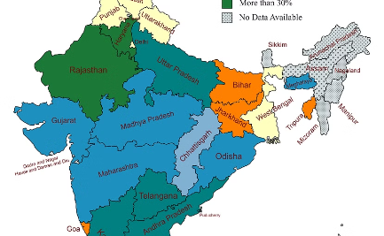
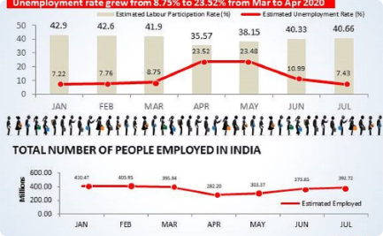
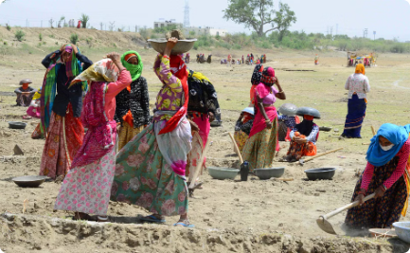
Visualizing Unemployment Patterns Across Regions and States
Geographical Disparities
Sectoral Trends
Urban-Rural Divide
Leveraging interactive maps to illustrate the uneven distribution of unemployment across different states and regions in India.
Utilizing data visualizations to highlight the variations in unemployment rates across different industries and economic sectors.
Exploring the differences in unemployment patterns between urban and rural areas, and identifying the unique challenges faced by each.

Slide 6




Identifying Trends and Insights from the Data
Trend Analysis
Examining long-term patterns and shifts in unemployment rates to identify key drivers and potential turning points.
Correlation Analysis
Exploring the relationships between unemployment and various economic, social, and demographic factors to uncover underlying dynamics.
Anomaly Detection
Identifying unusual or unexpected patterns in the data that may require further investigation or targeted interventions.

Slide 7
Methodology for Project Implementation
1
Data Collection
2
Data Cleaning and Preprocessing
Gathering comprehensive data from reliable sources on unemployment trends, demographics, and regional variations.
Ensuring the data is accurate, consistent, and ready for analysis by addressing missing values and outliers.
3
Exploratory Data Analysis
4
Visualization Techniques
Identifying patterns, trends, and relationships within the data to uncover insights and guide further investigation.
Employing a variety of visualization tools and methods to effectively communicate the findings and their implications.

